Slide 1
Predictive Analytics in Football
Predicting Top Goal Scorers -
OR-568 (Prof Vadim Sokolov)
Chanyoung Park
Hussain Alsharif
Oluwasegun Adegoke
Notes:
Welcome to our presentation on 'Predictive Analytics in Football'. Today, we will take a deep dive into how data analytics can be used to forecast the top goal scorers in football. We will explore various statistical models, their accuracy, and how these predictions can influence the game's future.

Slide 2

Introduction
Predictive analytics, a branch of advanced analytics, leverages data to make predictions about future events. In the world of sports, this translates to using player statistics, game results, and other relevant metrics to forecast future performances and outcomes.
In football, where player performance can be quantified in numerous ways, predictive analytics becomes a game-changer. It not only enhances our understanding of the game but also helps in strategic planning, player assessments, and predicting future stars.
Notes:
Predictive analytics is a critical aspect of advanced analytics that leverages historical data to make informed predictions about future events. In sports, this means analyzing player performance, game results, and various metrics to anticipate future outcomes. Specifically, in football, predictive analytics can revolutionize the game by enhancing our understanding, aiding in strategic planning, assessing players, and identifying future stars. The Premier League, with its competitive spirit and talented roster, provides an ideal dataset for such an analysis.

Slide 3
Our Goal
Our objective is to investigate whether the performance of football players in the first half of the season can be leveraged to predict the highest goal scorer by the end of the season.
Reason of selecting this topic
Expectation of project
- We are avid fans of the Premier League, deeply engaged with its teams and players
- The Premier League is a common thread that unites all of our group members.
- We believe the Premier League stands out as the premier football league globally, famous for its competitive spirit and talented players.
-Our study aims to show predictive analytics' usefulness in football, illustrating data's role in sports management and betting decisions.
-We anticipate challenges, especially with sports' inherent variability, which may result in low accuracy bcos of unseen variable like injuries
-We aim to offer practical insights and advice from our results, benefiting teams, coaches, and analysts.

Slide 4
About Data
Predictive
Analytics
Dataset was scraped from kickest
We have carefully selected a dataset that aligns with our research question and can provide us with the necessary information to predict the top goal scorer based on mid-season data.
We combined 50% of the 2019/2020, 2020/2021 and 2021/2022 season with their goals at the end of the season resulting 1442 observations and 26 features.
It includes detailed metrics such as goals, assists, shots, passes, and other relevant in-game statistics for each player.
This robust dataset serves as the backbone for our predictive models, offering a nuanced view of player performances in the league.
Notes:
We scrapped the dataset from kickest by using Json python code. We‘ve combined half-season data from three consecutive seasons with their goals at the end of the season resulting 1442 observations and 26 features. This includes detailed metrics like goals, assists, shots, and other in-game statistics, giving us a nuanced view of player performances.

Slide 5
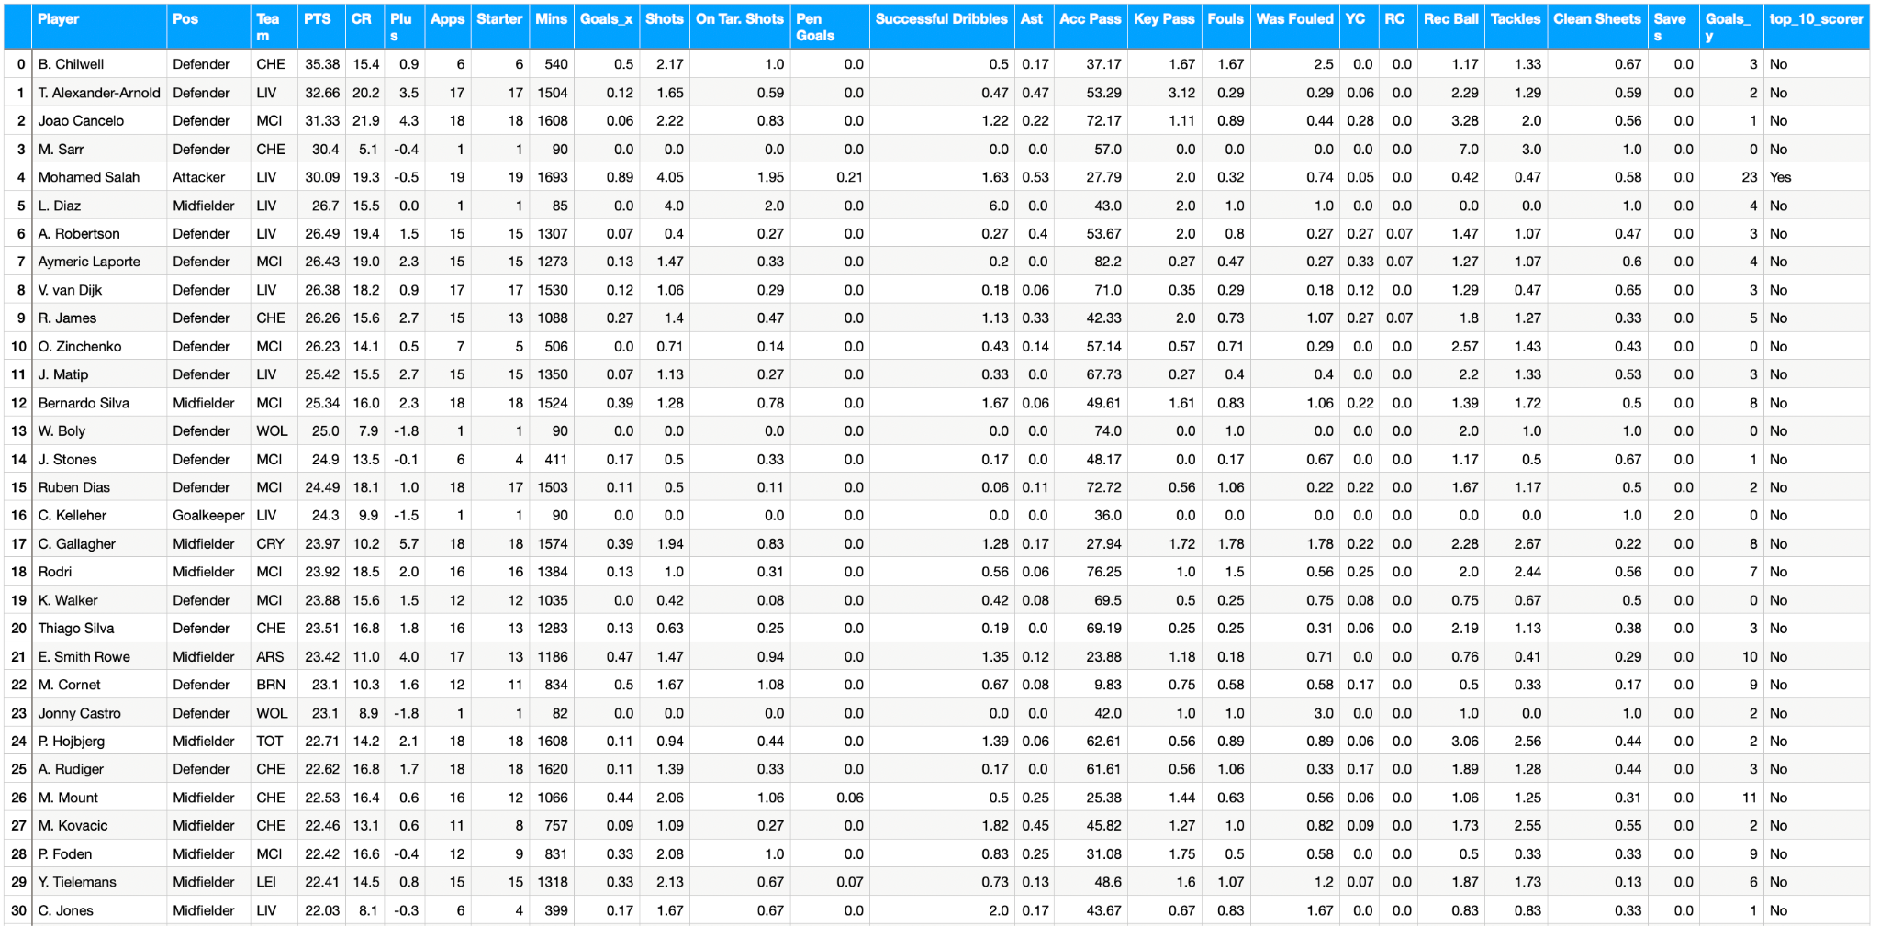
Dataset
Notes:
Here's a look at the dataset. when we used this dataset, we dropped the first four columns to ensure the models flexibility. This comprehensive view is crucial for accurate predictions.

Slide 6
Core Methods
With predictive analysis, it is advised to use different approaches. Therefore, different models were applied in this project:
Linear Regression, Random Forest, Boosting, and Deep Learning. Each offers a unique approach to predictive analysis, allowing us to compare and contrast their predictive capabilities.
1. Linear Model
2. Random Forest
3. Boosting model
4. Deep Learning
Notes:
With predictive analysis, it is advised to use different approaches. Therefore, different models were applied in this project:
Linear Regression, Boosting, Random Forest, and Deep Learning. Each offers a unique approach to predictive analysis, allowing us to compare their predictive capabilities.

Slide 7
Linear Model
Model 1: Kitchen sink
Model 2: Interactions
Model 3: P-value Hack
- R-Squared: 0.8062 (80.62% of the variance explained)
-RMSE: 1.5599 (Indicates the typical prediction error)
-# P-value predictors < 0.1 = Ten
-MAE : 1.095538
-Intercept: -1.450
-R-Squared: 0.9342 (93.42% of the variance explained)
-RMSE: 1.471316 (Lowest error, indicating highest prediction accuracy)
-# P-value predictors < 0.1 = 46
-MAE: 0.9827922
- Intercept: -0.1958
-R-Squared: 0.9336 (93.36% of the variance explained)
-RMSE: 1.475439 (Reduced error compared to Model 1 )
- Used only the 46 significant predictors in model 2
-MAE: 0.9757574
- Intercept: -0.06101
The second model showed a Prediction Accuracy with an RMSE value of 1.47 on the test dataset, indicating high predictive accuracy."
It successfully predicted Mohamed Salah as the top scorer, aligning with the actual outcome.
We tried standardize the dataset but had no effect on the models
Notes:
We developed three variations of Linear Models, each offering a different level of complexity. On this slide, we compare the three linear models. Model 1 takes a broad approach an results in an R-squared of 80.62%, but Model 2 hones in on interactions between variables, lifting the R-squared to an impressive 93.42% and achieving our lowest RMSE, indicating high accuracy. Pause. Model 3, the 'P-value Hack,' method keeps only the significant predictors from Model 2, maintaining a high R-squared of 93.36%. All models were able to predict Mohamed Salah as the top scorer, which aligns with the actual outcome—a testament to our model's precision.

Slide 8
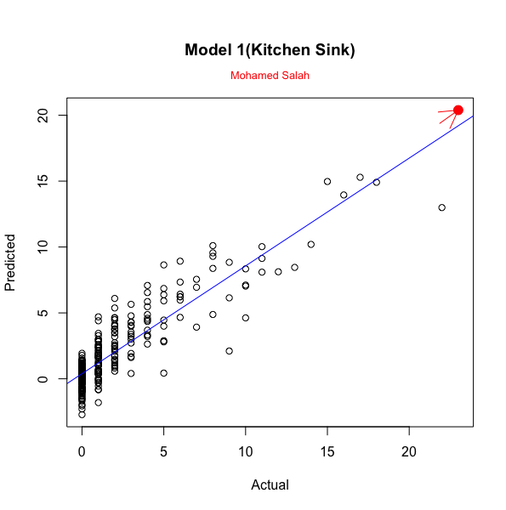
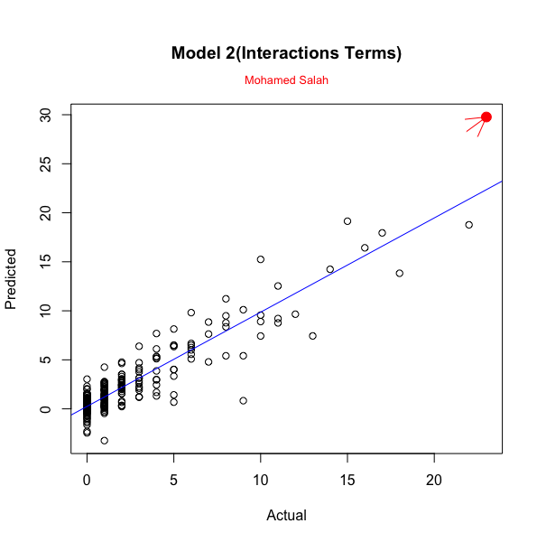

Linear Model
Notes:
These scatter plots compare our models' predicted goals against actual goals. Model 1's plot shows potential, but Models 2 and 3 demonstrate greater accuracy, as seen in the close clustering around the best-fit line, with Salah's prediction being particularly accurate.

Slide 9
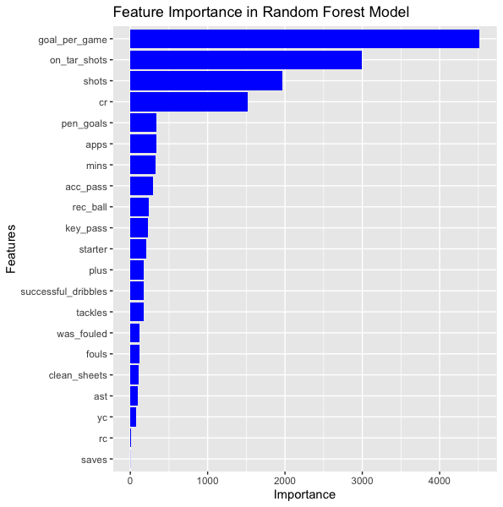
Random Forest Model
Su
Performance Metrics:
Accuracy: 48.61%
Root Mean Squared Error (RMSE): 1.438381
Mean Absolute Error (MAE): 0.8627999
Stabilized at 500 trees
Confusion Matrix Insights:
High sensitivity in correctly identifying non-scorers (Class 0).
Specificity indicates good true negative rate across classes.
Balanced accuracy varied, reflecting class imbalances.
Model Highlights:
Successfully predicted Mohamed Salah as the top goal scorer.
Demonstrates robust predictive capability and is better than Boosting
Notes:
Next, the Random Forest Model exhibits an accuracy of 48.61% with a MAE of 0.86, signifying its accuracy in predictions. The model stands out for its sensitivity in identifying non-scorers and balancing class imbalances. The feature importance plot underscores 'goal_per_game' as the dominant predictor. This model's predictive power shines through in successfully identifying Mohamed Salah as the top scorer.

Slide 10
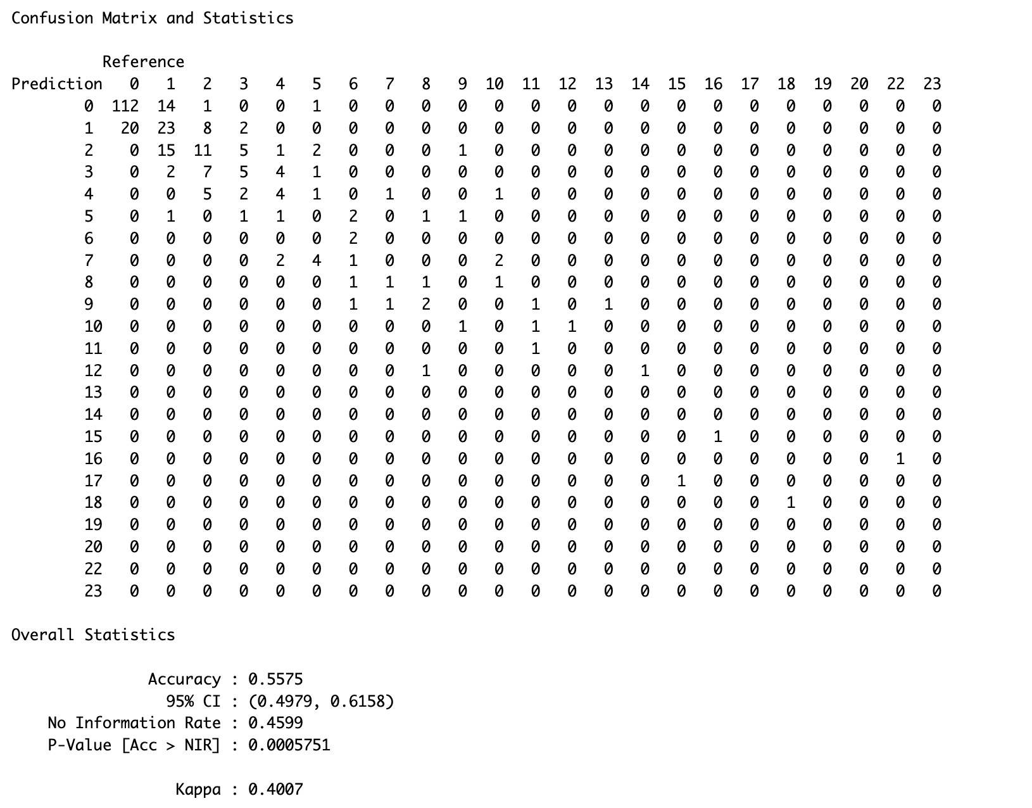
Boosting Model
Model Type: Gradient Boosting Machine (GBM)
Key Model Parameters:
Number of Trees: 900
Interaction Depth: 5
Learning Rate (Shrinkage): 0.01
Cross-Validation Folds: 10
Minimum Observations per Node: 8
Performance Metrics:
Model Accuracy: 55.75%
Kappa Score: 0.4007 (Indicates Moderate Predictive Power)
Mean Absolute Error (MAE): 0.795233
Root Mean Squared Error: 1.292113
Feature Importance: Top Influential Features: 'goal_per_game', 'shots', 'appearances'
Model Highlights:
Successfully predicted Mohamed Salah as the top goal scorer.
Demonstrates the model's effectiveness in identifying key players’ performance.
Notes:
Our Boosting Model, a Gradient Boosting Machine, holds a solid ground with an accuracy of 55.75% and a MAE of 0.795, showing its ability to make close predictions. It's engineered with a nine hundred trees and depth of 5, finely tuned to pick out 'goal_per_game', 'shots' as important features. Notably, it spotlighted Mohamed Salah as the top goal scorer, which is a testament to the model's effectiveness.

Slide 11
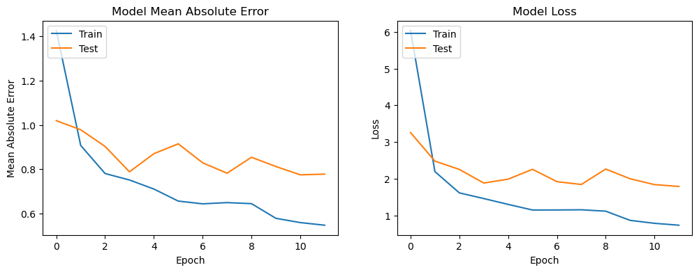
Deep Learning
Model Architecture:
Type: Sequential Neural Network
Layers:
Dense Layer: 256 neurons, activation='relu'
Dense Layer: 128 neurons, activation='relu'
Dense Layer: 64 neurons, activation='relu'
Dense Layer: 32 neurons, activation='relu'
Output Layer: 1 neuron
Optimizer: 'adam'
Loss Function: 'mean_squared_error'
Performance Metrics: 'mean_absolute_error'
Training and Validation:
Epochs: 12
Model Performance:
Test Loss: 2.0596
Test Mean Absolute Error: 0.7455
Key Insights:
The model successfully predicted Mohamed Salah as the top goal scorer.
Prediction closely aligns with actual goal scores, indicating high model accuracy.
Notes:
Lastly, our Deep Learning model, this model's architecture contains multiple dense layers with 'relu' activation, culminating in an output layer with a single neuron. It's was trained using the 'adam' optimizer and evaluated using the 'mean_squared_error' loss function, with 'mean_absolute_error' as our performance metric. During training over 12 epochs, we see the model's loss and mean absolute error on both the training and test sets. The descending lines in the graphs indicate the model learnt effectively, with test loss settling at 2.0596 and a promising mean absolute error of 0.7455, which speaks to the model's ability to make precise predictions.

Slide 12
Models Comparison
Model | RMSE | MAE | Accuracy
Linear Model | 1.471316 | 0.9827922 | 43.32%
Boosting model | 1.292113 | 0.792431 | 55.75%
Random Forest | 1.4383 | 0.8627 | 48.61%
Deep Learning | 1.4351 | 0.7455 | 49.13%
Notes:
In this slide, we have a side-by-side comparison of our four models. The Linear Model has yielded the lowest accuracy of 43.32%, and has an RMSE of 1.47, indicating its low precision in prediction. The Boosting Model outperforms in accuracy at 55.75% and an RMSE of 1.24, suggesting its high precision in predicting closer to actual values.
The Random Forest and Deep Learning models show a balance between accuracy and error metrics, highlighting their potential for precision despite their modest accuracy percentages. Together, these metrics guide us in selecting the right model for our predictive task based on our criteria which is accuracy or the proximity of predictions to actual results.

Slide 13
Applications
Serie A league
Best Model: Boosting Model
Boosting Model appears to be the best model for this prediction task. It has been highlighted for its superior accuracy and lower error metrics compared to the other models.
Linear Performance Metrics:
Accuracy: 49.89%
Root Mean Squared Error (RMSE): 1.3868
Boosting Performance Metrics:
Accuracy: 54.3%
Root Mean Squared Error (RMSE): 1.1990
Random Forest Performance Metrics:
Accuracy: 48.54%
Root Mean Squared Error (RMSE): 1.3082
Deep Learning Performance Metrics:
Accuracy: 43.56%
Root Mean Squared Error (RMSE): 1.2753
Su
Top Scorers Across All Models
Linear Model | Boosting Model | Forest Model | Deep Learning | Actual
V. Osimhen | V. Osimhen | V. Osimhen | V. Osimhen | V. Osimhen
M. Lautaro | M. Lautaro | M. Lautaro | M. Lautaro | M. Lautaro
R. Leao | K. Kvaratskhelia | K. Kvaratskhelia | D. Vlahovic | R. Leao
D. Vlahovic | R. Leao | R. Leao | K. Kvaratskhelia | A. Lookman
D. Berardi | C. Immobile | D. Vlahovic | A. Lookman | Bala Nzola
Notes:
We extended our analysis to Italy's Serie A to test our models' flexibilityand whether it can be applied to other leagues or not. The varying performance metrics across models underscore the adaptability of our methods and their potential application across different leagues.
While all models predict the top two actual scorers correctly, the linear model predicts the top three scorers. However, all models fail to predict Nzolo as one of the top scorers.

Slide 14
Limitations
Data Constraints: Limited to specific seasons and may not account for all variables affecting a player's performance (e.g., injuries, transfers).
Model Bias: Potential biases in the models due to the data used. Need for more diverse datasets to improve model robustness.
Dynamic Nature of Football: The unpredictable nature of sports, including player form fluctuations and tactical changes, can impact model accuracy.
Future Research
Incorporating More Data: Expand dataset to include more seasons, leagues, and player-specific data like fitness levels or psychological factors.
Player Development Focus: Shift from predicting top goal scorers to identifying potential star players based on early-career performance data.
Interdisciplinary Approaches: Collaborate with sports scientists and psychologists to integrate physical and mental health metrics into predictive models.
Notes:
The dataset may be limited to specific seasons and may not account for all variables affecting a player's performance (e.g., injuries, transfers). This could lead to potential biases in the models. In order to address this issue, the dataset could be expanded to include more seasons, leagues, and player-specific data like fitness levels or psychological factors.
Another limitation is the dynamic nature of Football or the unpredictable nature of sports, including player form fluctuations and tactical changes which can impact model accuracy. Therefore, the model's objective may be shifted from predicting top goal scorers to, for example, identifying potential star players based on early-career performance data. Also, collaborating with sports scientists and psychologists to integrate physical and mental health metrics into predictive models can lead to more accurate results.

Slide 15

Conclusion
The primary objective of our project was to utilize predictive analytics to forecast the season's top goal scorer from mid-season performance data.
Our comprehensive analysis determined that the Boosting Model outperformed other models with the highest accuracy, validating our hypothesis.
The success of the Boosting Model highlights the potential of machine learning in sports analytics and its impact on strategic decision-making.
We advocate for a diverse modeling approach, as it's critical for robust and resilient predictions in dynamic environments like football.
This project underscores the importance of data-driven insights in football strategies and enhancing the understanding of player performance.
1
2
Best RMSE
Best Accuracy
1.29
55.75%
Notes:
To conclude, we reflect on our key findings, the primary objective of our project was to use predictive analytics to predict the season's top goal scorer from mid-season performance data.
Our comprehensive analysis determined that the Boosting Model outperformed other models with the highest accuracy, validating our hypothesis. The success of the Boosting Model highlights the potential of machine learning in sports analytics and its impact on strategic decision-making.
This project underscores the importance of data-driven insights in football strategies and enhances the understanding of player performance. Our models predict the top goal scorer accurately across all datasets, for the Premier League it was Mo Salah. The best models is the Boosting one with…

Slide 16
Q&A

Slide 17


Thanks

